Slide 1



IPL AUCTION Project
Developing auction strategy for new IPL franchise by analyzing past IPL data to create a strong and balanced squad.
Presented by-
Mansi Garg
Internshala
Data science pgc

Slide 2
Table of contents
Slide No | Topic
3- 4 | Query, data and graph for players with high S.R who have faced at least 500 balls
5-6 | Query, data and graph for players with good Average who have played more the 2 IPL seasons.
7-9 | Query, data and graph for Hard-hitting players who have scored most runs in boundaries and have played more the 2 IPL season.
10-11 | Query, data and graph for bowlers with good economy who have bowled at least 500 balls in IPL so far.
12-13 | Query, data and graph for bowlers with the best strike rate and who have bowled at least 500 balls in IPL so far.
14-15 | Query, data and graph for All rounders with the best batting as well as bowling strike rate and who have faced at least 500 balls in IPL so far and have bowled minimum 300 balls.
16-18 | Query, data , graph and analysis for selection of fielders on the basis of maximum dismissals.
19-27 | Queries and graphs for additional 10 questions.

Slide 3
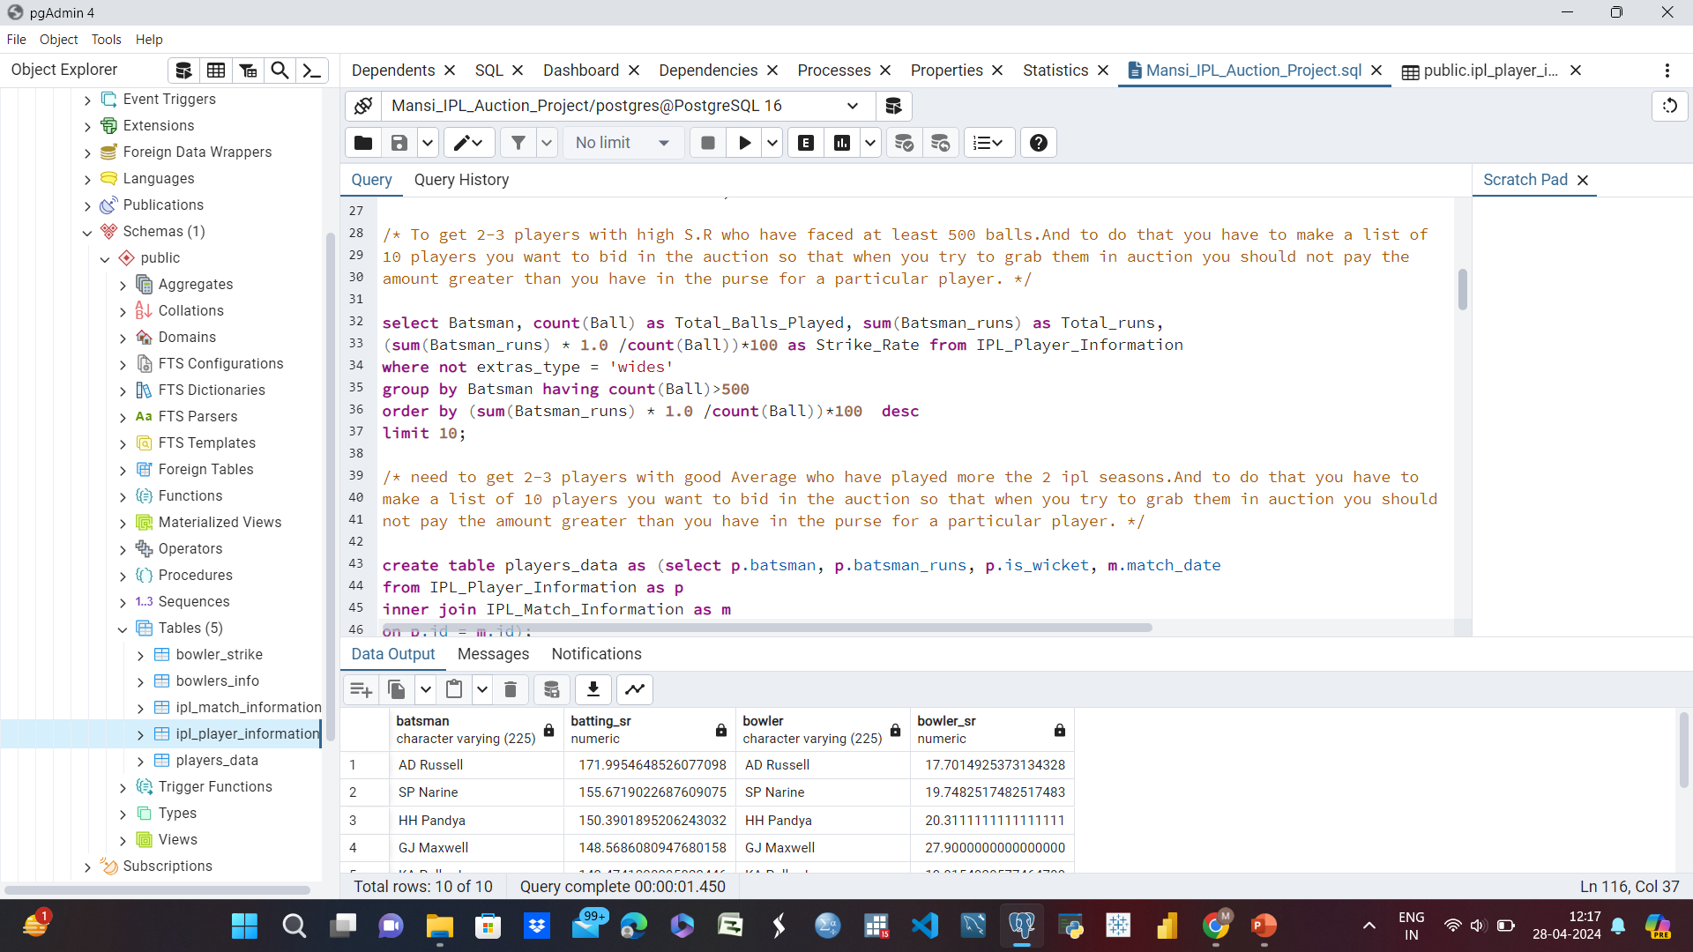
Query run-Player with high strike rate with more than 500 balls faced.

Slide 4
Player with high strike rate with more than 500 balls faced.
Batsman | Total Balls Played | Total Runs | Strike Rate
AD Russell | 832 | 1517 | 182.33
SP Narine | 543 | 892 | 164.27
HH Pandya | 847 | 1349 | 159.27
V Sehwag | 1755 | 2728 | 155.44
GJ Maxwell | 973 | 1505 | 154.68
RR Pant | 1368 | 2079 | 151.97
AB de Villiers | 3192 | 4849 | 151.91
CH Gayle | 3179 | 4772 | 150.11
KA Pollard | 2017 | 3023 | 149.88
JC Buttler | 1146 | 1714 | 149.56

Slide 5
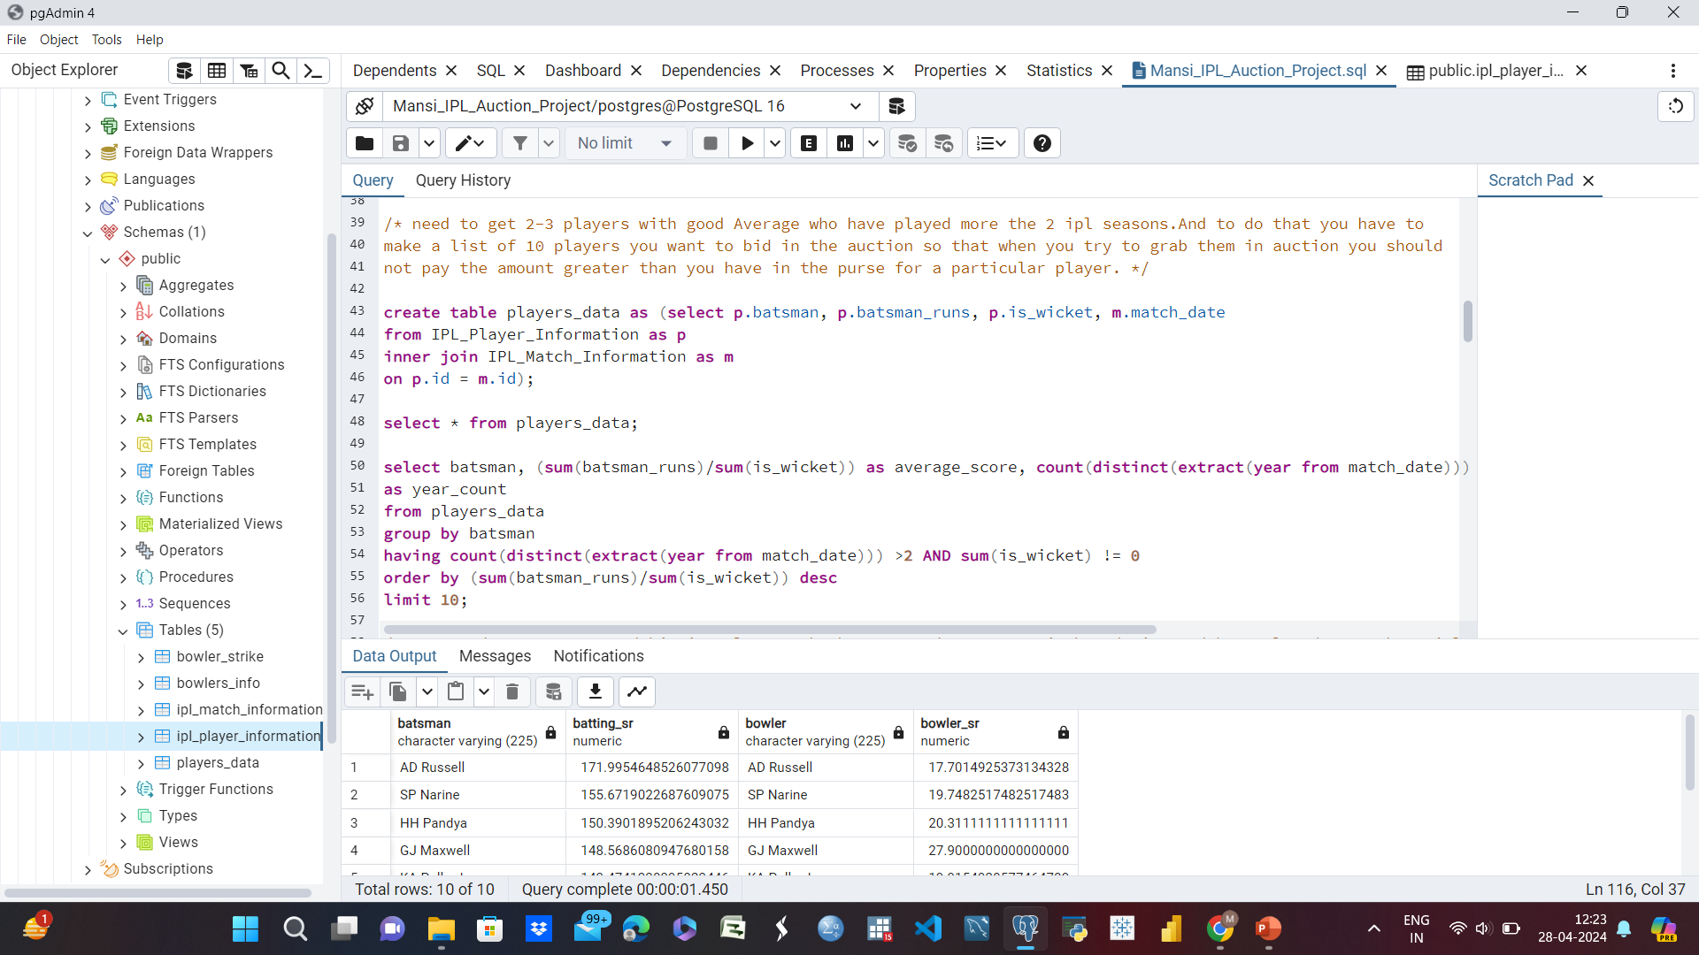
Players played more than 2 seasons with good average runs.

Slide 6
Players played more than 2 seasons with goof average runs.
Batsman | Average Score | Year Count
Iqbal Abdulla | 88 | 8
AB de Villiers | 42 | 13
KL Rahul | 42 | 7
ML Hayden | 41 | 3
JP Duminy | 41 | 8
CH Gayle | 41 | 12
DA Warner | 41 | 11
KS Williamson | 39 | 6
LMP Simmons | 39 | 4
MEK Hussey | 38 | 7

Slide 7
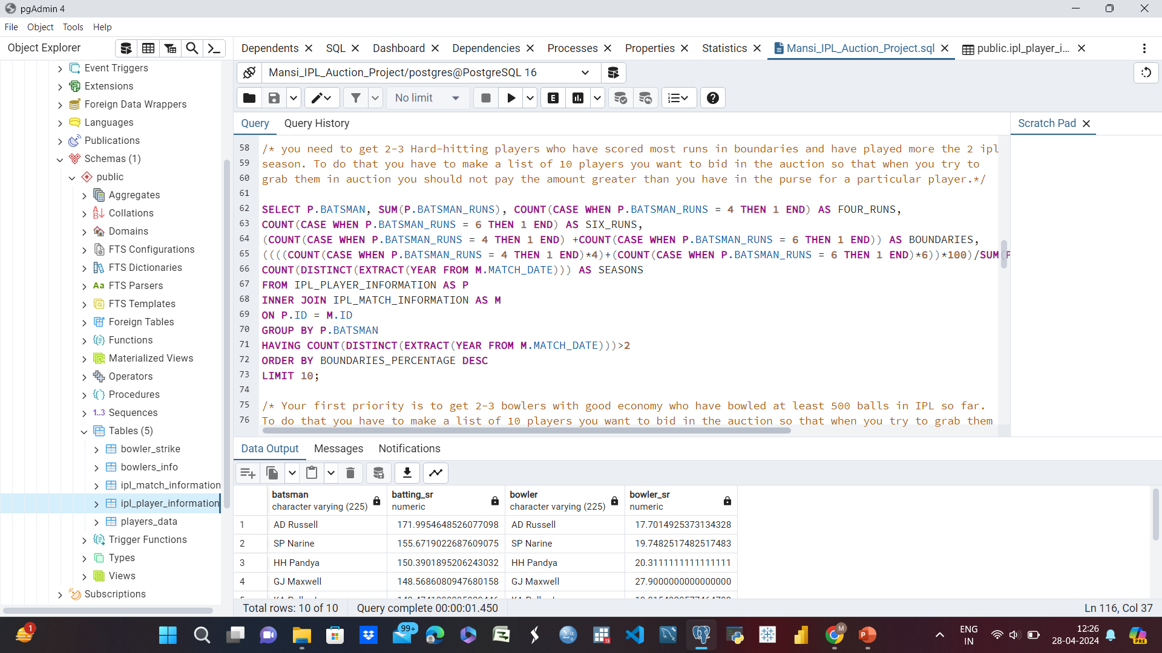
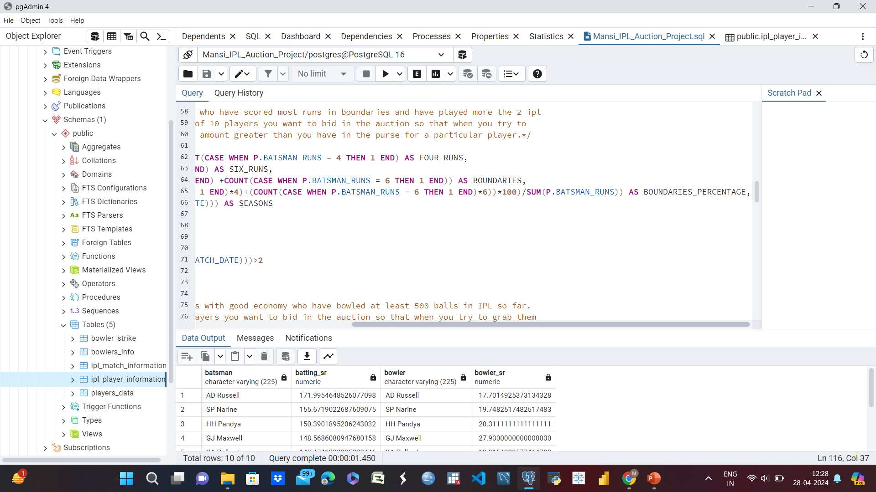
Query run- Players with maximum boundaries percentage and played more than 2 seasons.

Slide 8
Players with maximum boundaries percentage and played more than 2 seasons.
Batsman | Total Runs | Four Runs | Six Runs | Boundaries | Boundaries Percentage | Seasons
SP Narine | 892 | 103 | 52 | 155 | 81% | 9
AD Russell | 1517 | 105 | 129 | 234 | 78% | 8
CH Gayle | 4772 | 384 | 349 | 733 | 76% | 12
CR Brathwaite | 181 | 10 | 16 | 26 | 75% | 4
ST Jayasuriya | 768 | 84 | 39 | 123 | 74% | 3
BCJ Cutting | 238 | 15 | 19 | 34 | 73% | 5
MS Gony | 99 | 6 | 8 | 14 | 72% | 6
KK Cooper | 116 | 9 | 8 | 17 | 72% | 3
AC Gilchrist | 2069 | 239 | 92 | 331 | 72% | 6
MJ McClenaghan | 85 | 5 | 7 | 12 | 72% | 5

Slide 10
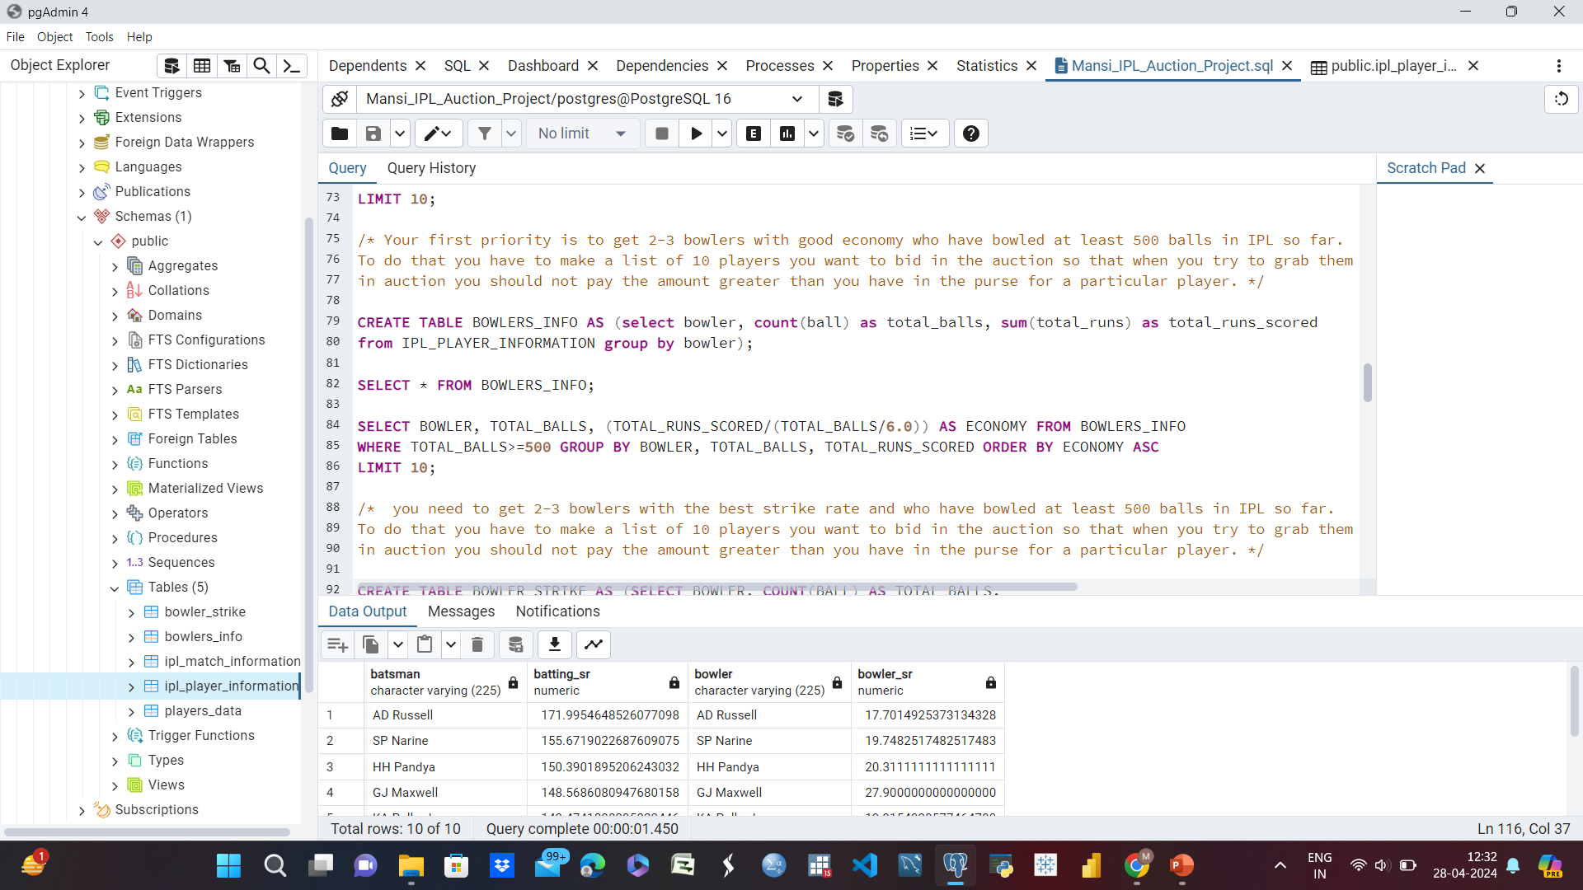
Query run- Players (Bowlers) having good economy with at least 500 balls bowled.

Slide 11
Players (Bowlers) having good economy with at least 500 balls bowled.
Bowler | Total balls | Economy
Rashid Khan | 1490 | 6.334228
A Kumble | 983 | 6.646999
M Muralitharan | 1577 | 6.677235
DW Steyn | 2276 | 6.769772
R Ashwin | 3327 | 6.77367
SP Narine | 2824 | 6.815864
DL Vettori | 785 | 6.833121
Washington Sundar | 660 | 6.890909
J Botha | 709 | 6.922426
R Tewatia | 587 | 6.991482

Slide 12
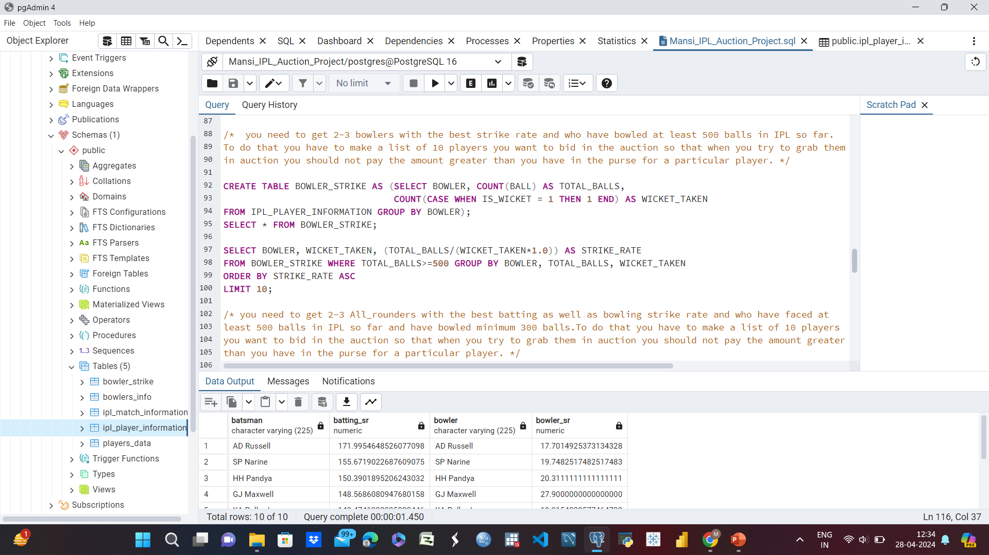
Query run - Players (Bowlers) having good strike rate with at least 500 balls bowled.

Slide 13
Players (Bowlers) having good strike rate with at least 500 balls bowled.
Bowler | Wicket Taken | Strike Rate
K Rabada | 66 | 12.7
DE Bollinger | 43 | 14.0
AJ Tye | 45 | 14.3
MA Starc | 39 | 15.7
SL Malinga | 188 | 15.8
Imran Tahir | 83 | 15.8
DJ Bravo | 175 | 16.3
A Nehra | 121 | 16.3
S Aravind | 48 | 16.4
KK Cooper | 36 | 16.7

Slide 14
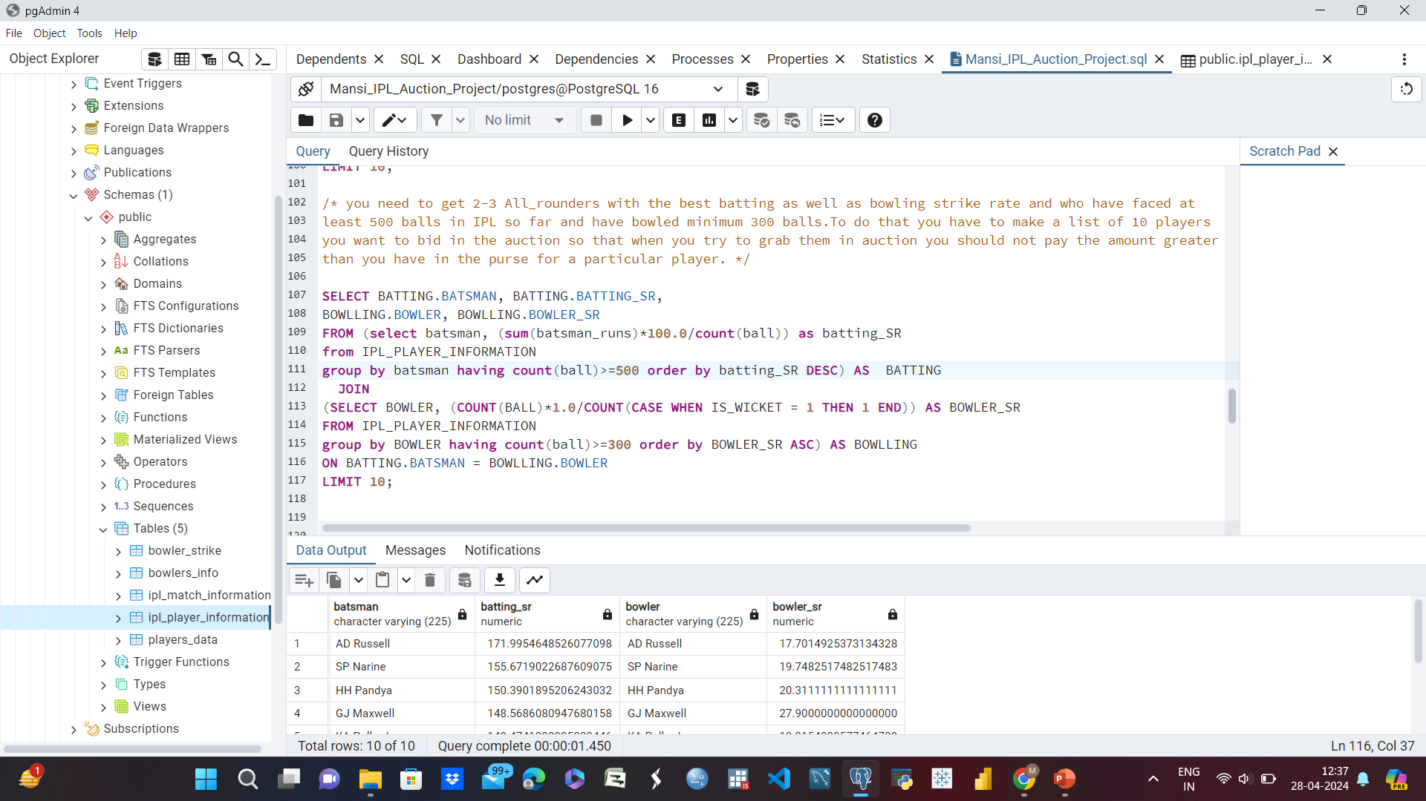
Query run- All rounder players having best batting and bowling strike rate with more 500 balls faced and more than 300 balls bowled.
Batsman | Batting SR | Bowler | Bowler SR
AD Russell | 172.00 | AD Russell | 17.70
SP Narine | 155.67 | SP Narine | 19.75
HH Pandya | 150.39 | HH Pandya | 20.31
GJ Maxwell | 148.57 | GJ Maxwell | 27.90
KA Pollard | 143.47 | KA Pollard | 19.92
CH Gayle | 142.79 | CH Gayle | 30.74
KH Pandya | 137.55 | KH Pandya | 26.18
YK Pathan | 137.51 | YK Pathan | 25.74
JA Morkel | 136.99 | JA Morkel | 18.82
SR Watson | 134.14 | SR Watson | 19.97

Slide 16
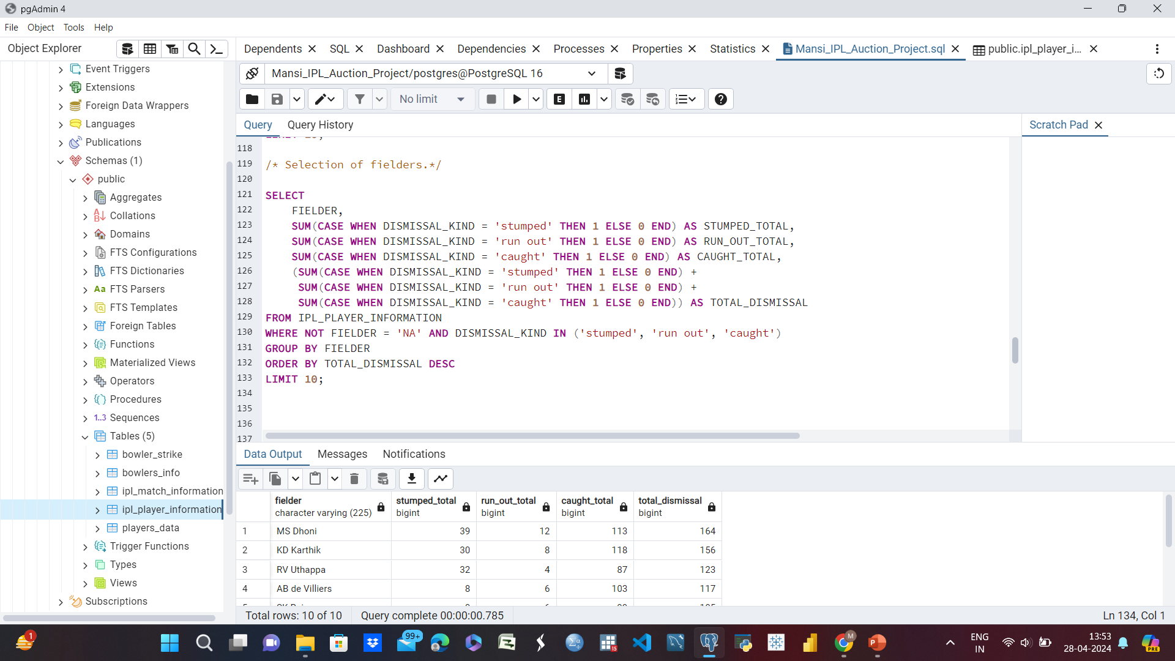
Query run – Selection of top 10 fielders.
fielder | Stumped total | Run out total | Caught total | Total dismissal
MS Dhoni | 39 | 12 | 113 | 164
KD Karthik | 30 | 8 | 118 | 156
RV Uthappa | 32 | 4 | 87 | 123
AB de Villiers | 8 | 6 | 103 | 117
SK Raina | 0 | 6 | 99 | 105
RG Sharma | 0 | 4 | 88 | 92
PA Patel | 16 | 6 | 69 | 91
KA Pollard | 0 | 4 | 84 | 88
V Kohli | 0 | 7 | 76 | 83
WP Saha | 20 | 1 | 62 | 83

Slide 18
Analysis
For the selection of best fielders for the team the following measures have been taken-
Selecting 3 types of dismissals – stumped, run out and caught.
Associating the total sum of each dismissal kind along with total dismissal with fielder’s name.
Arranging the data in descending order in context of total dismissals and selecting the top 10 fielders.

Slide 19
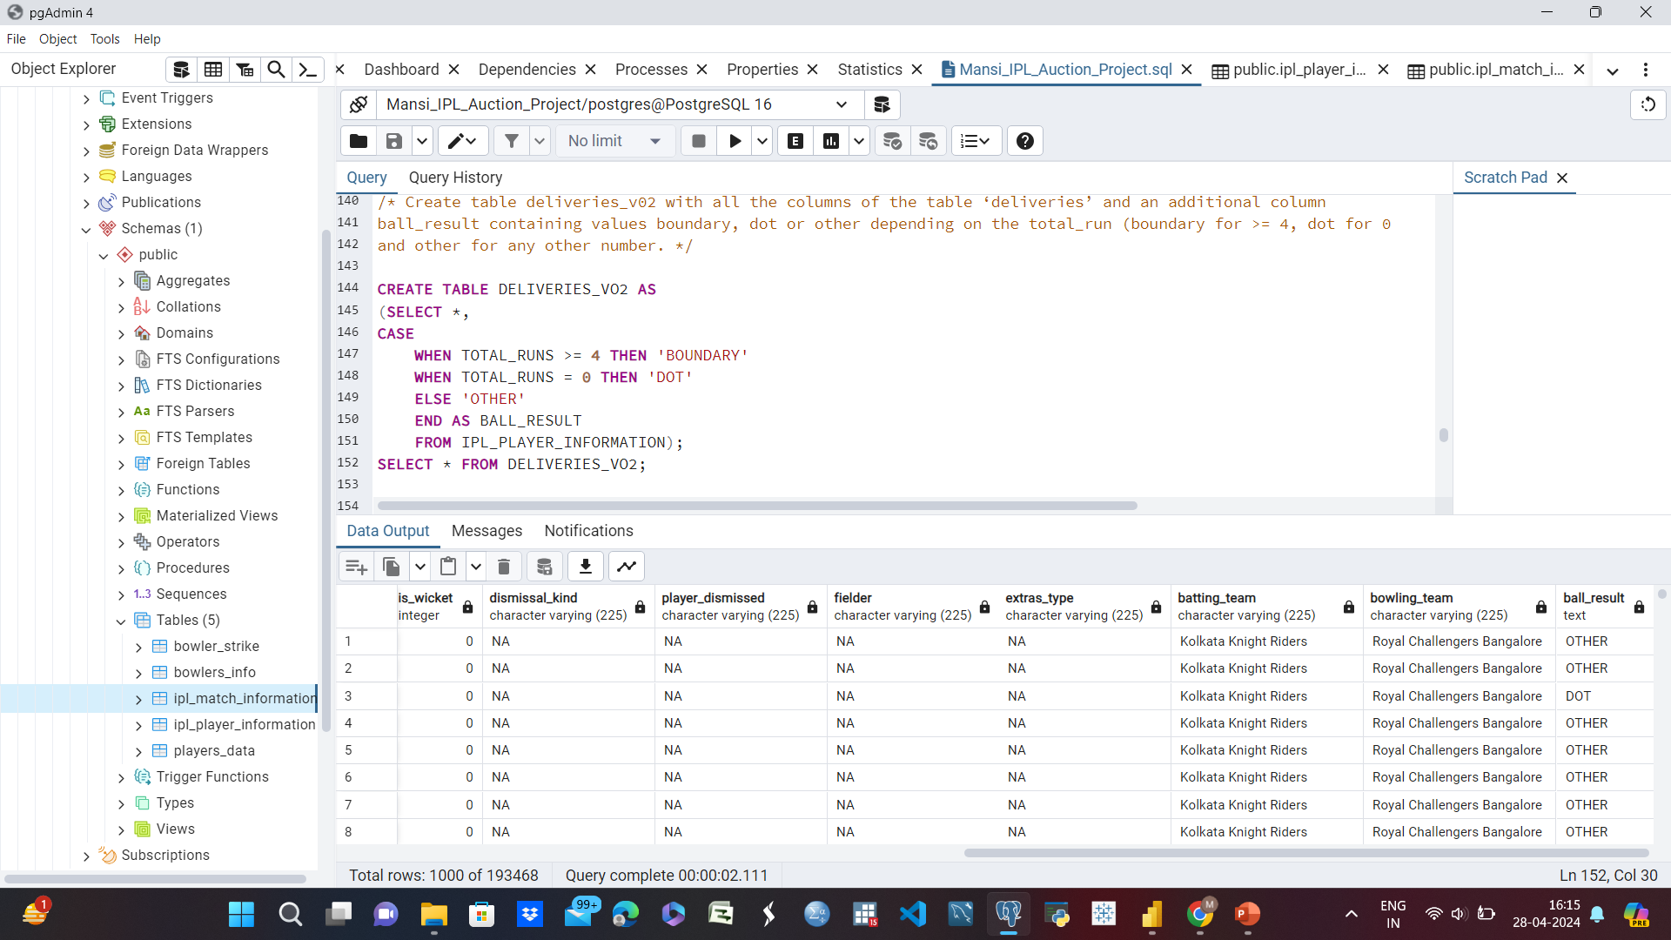

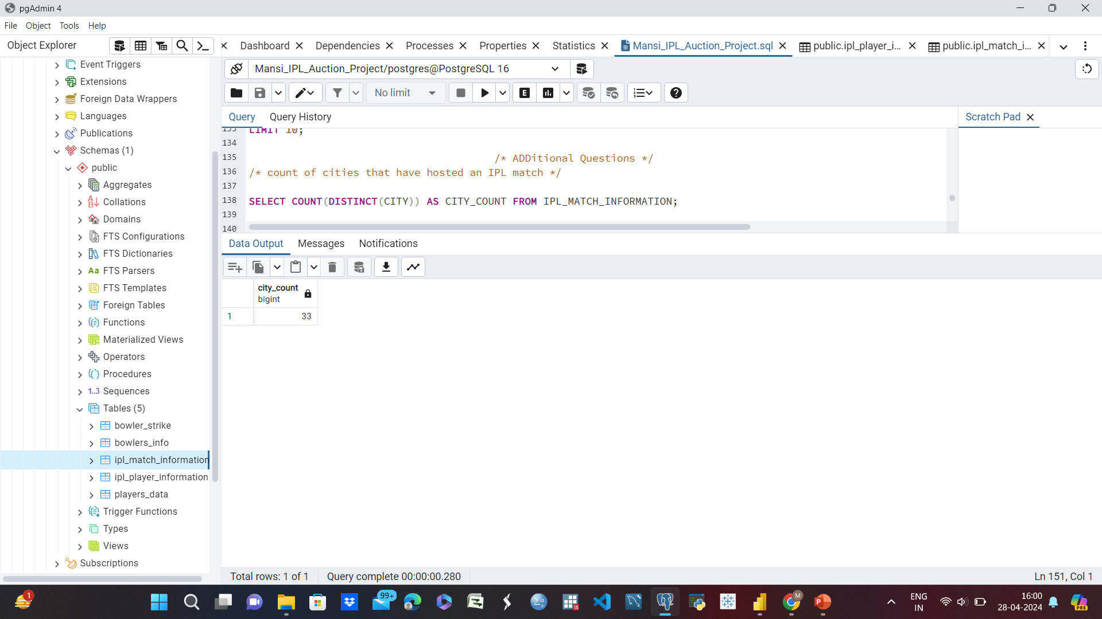

Additional Questions
1. count of cities that have hosted an IPL match
2. Create table deliveries_v02 with all the columns of the table ‘deliveries’ and an additional column ball_result containing values boundary, dot or other depending on the total_run (boundary for >= 4, dot for 0 and other for any other number.

Slide 20
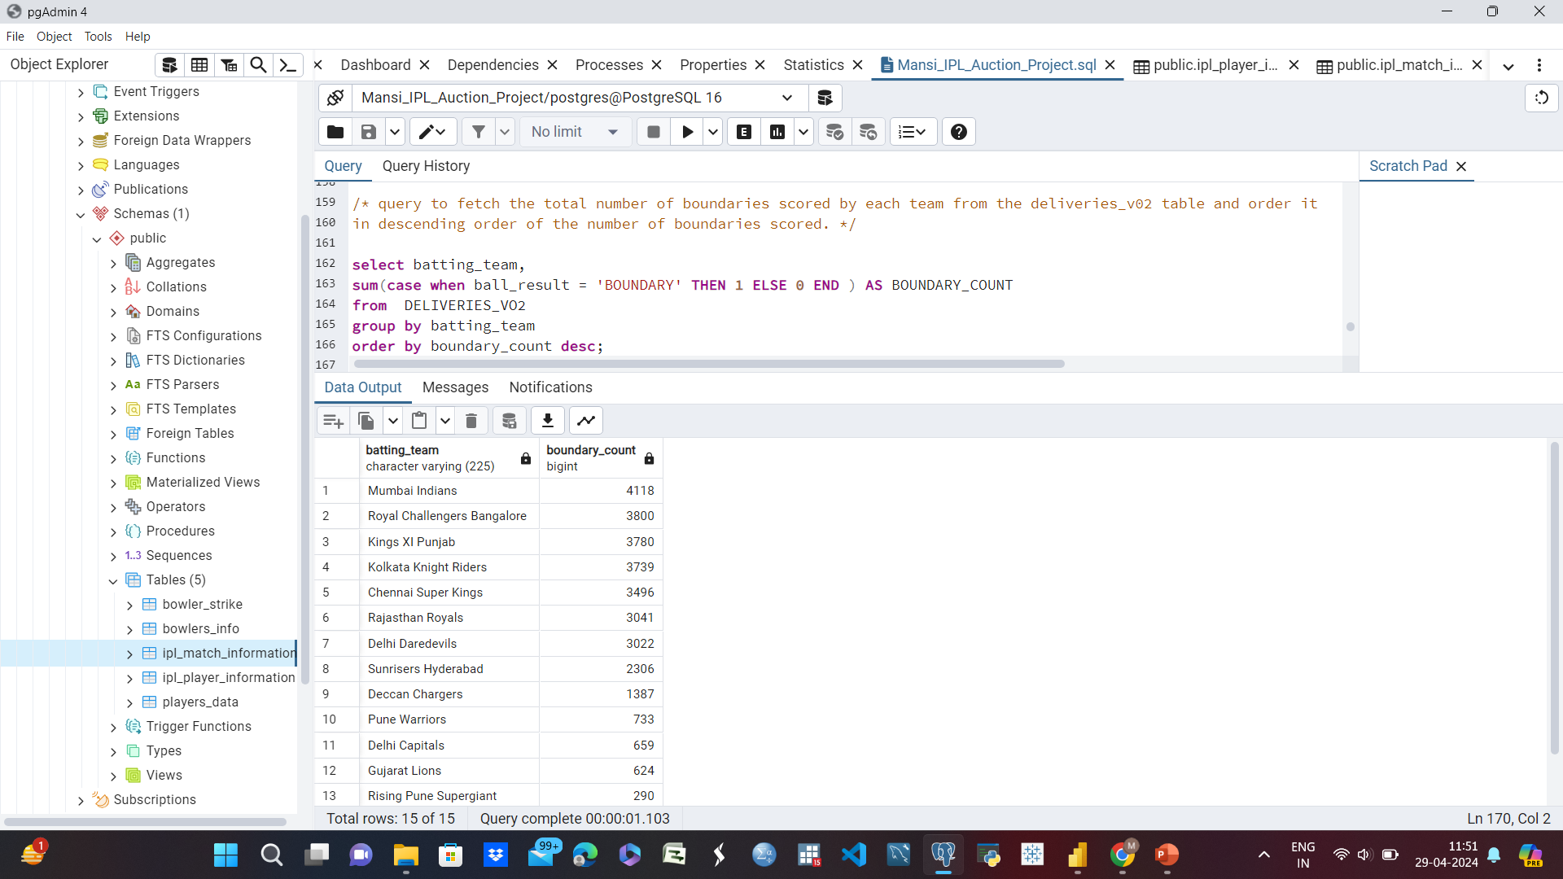
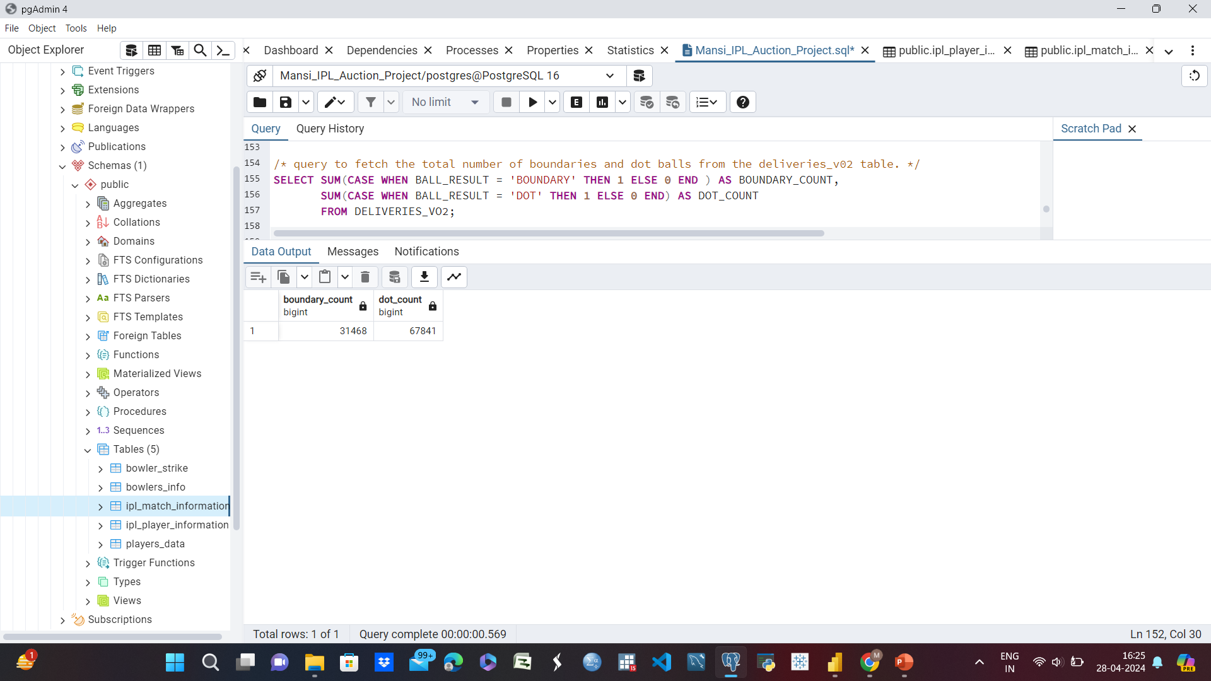
Additional Questions
3. query to fetch the total number of boundaries and dot balls from the deliveries_v02 table
4. Query to fetch the total number of boundaries scored by each team from the deliveries_v02 table and order it in descending order of the number of boundaries scored.

Slide 22
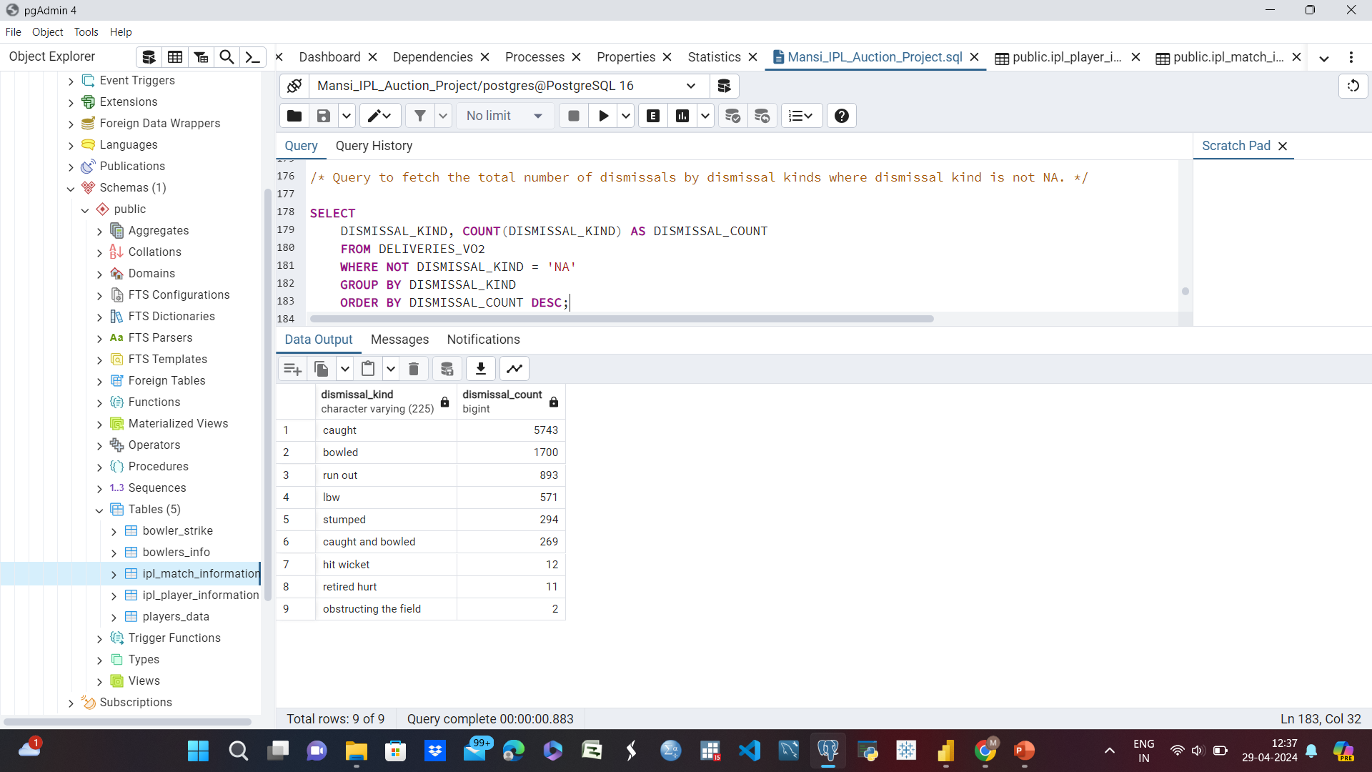
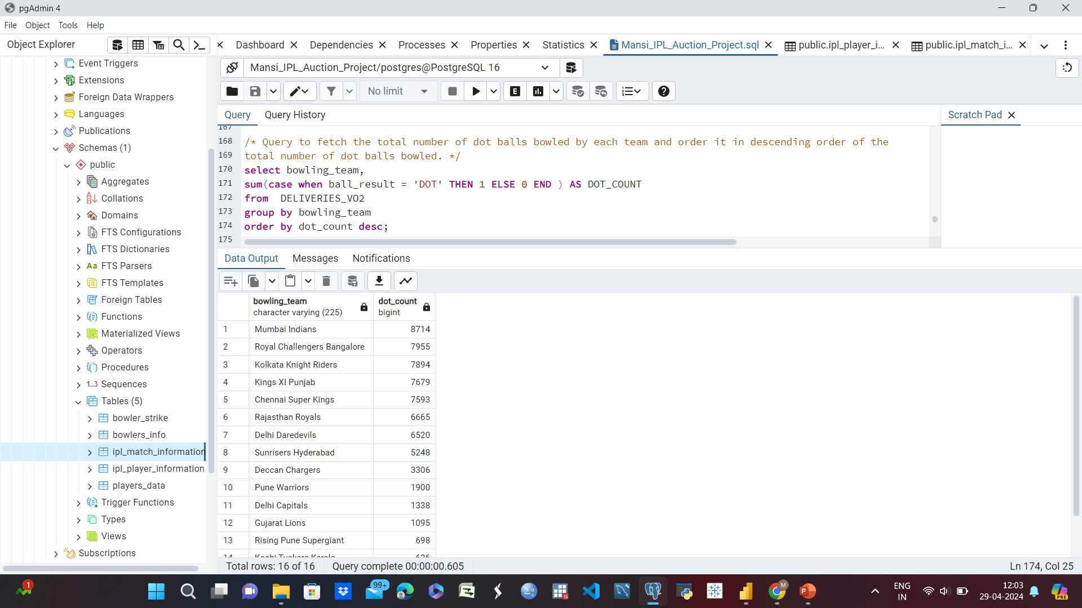
Additional Questions
5. Query to fetch the total number of dot balls bowled by each team and order it in descending order of the total number of dot balls bowled.
6. Query to fetch the total number of dismissals by dismissal kinds where dismissal kind is not NA.

Slide 24
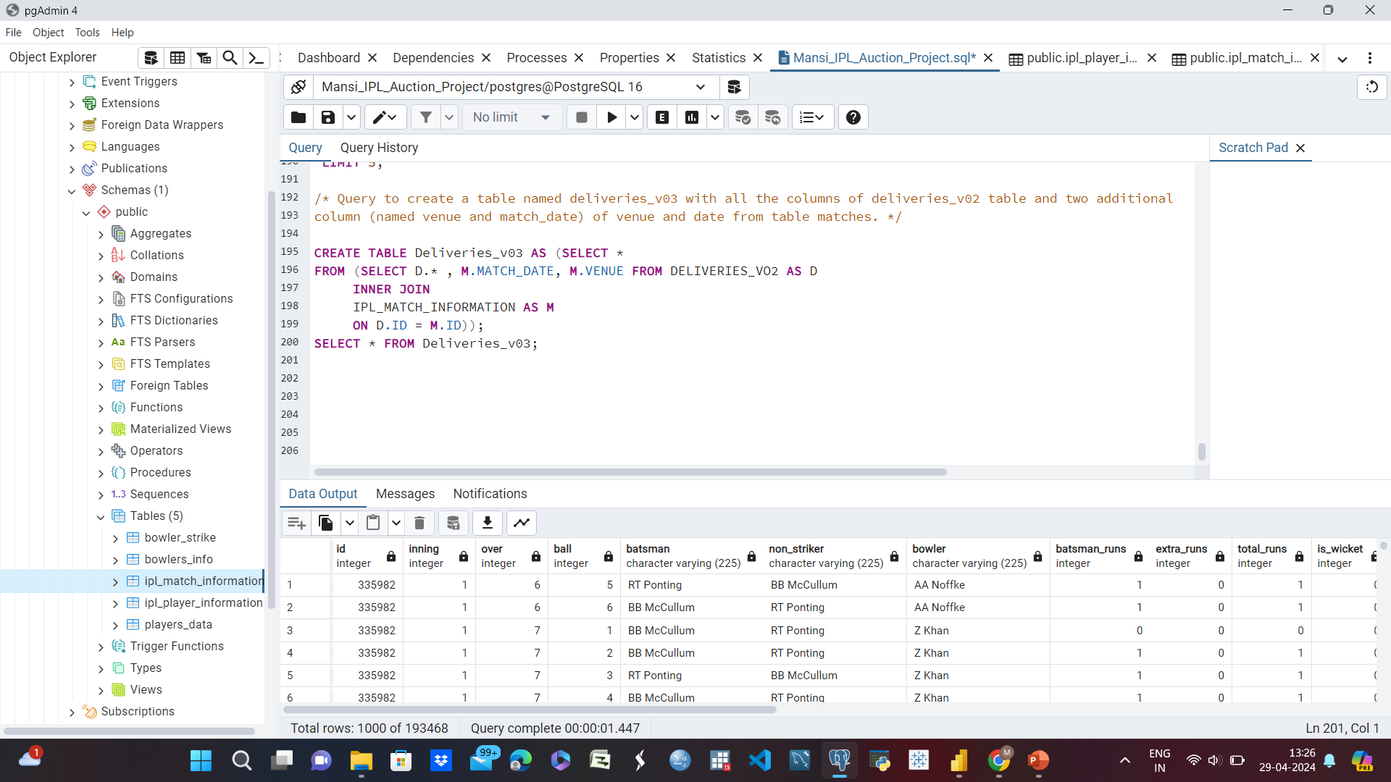
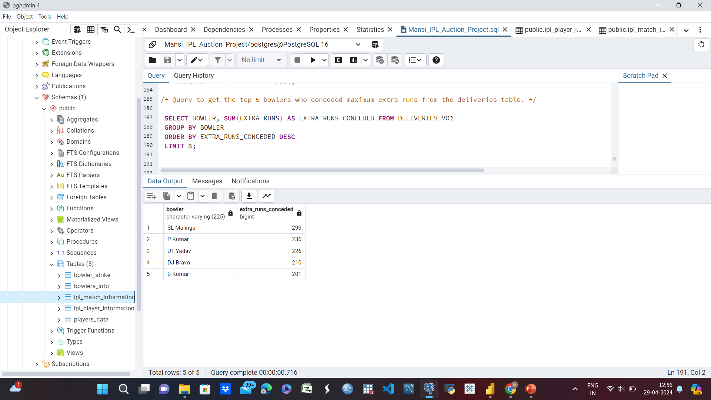
Additional Questions
7. Query to get the top 5 bowlers who conceded maximum extra runs from the deliveries table.
8. Query to create a table named deliveries_v03 with all the columns of deliveries_v02 table and two additional column (named venue and match_date) of venue and date from table matches.

Slide 26
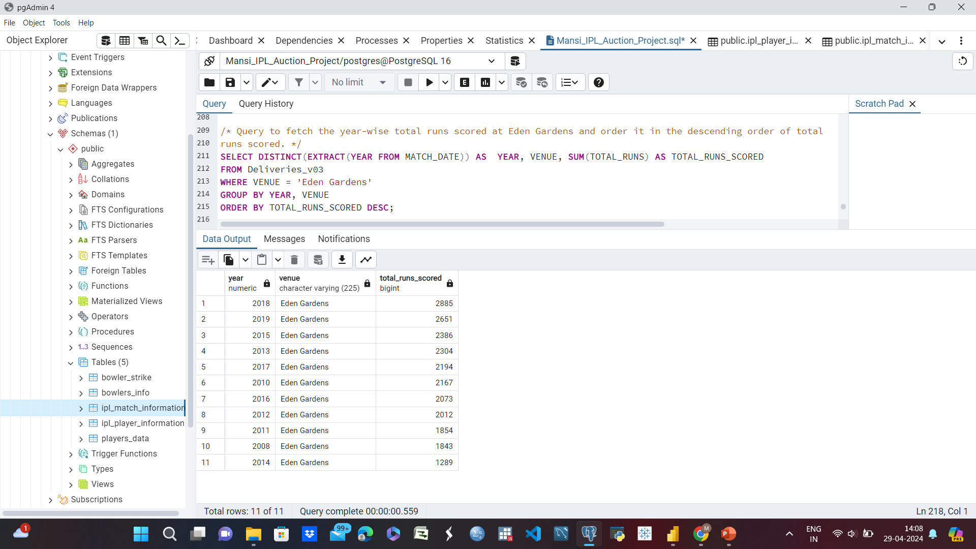
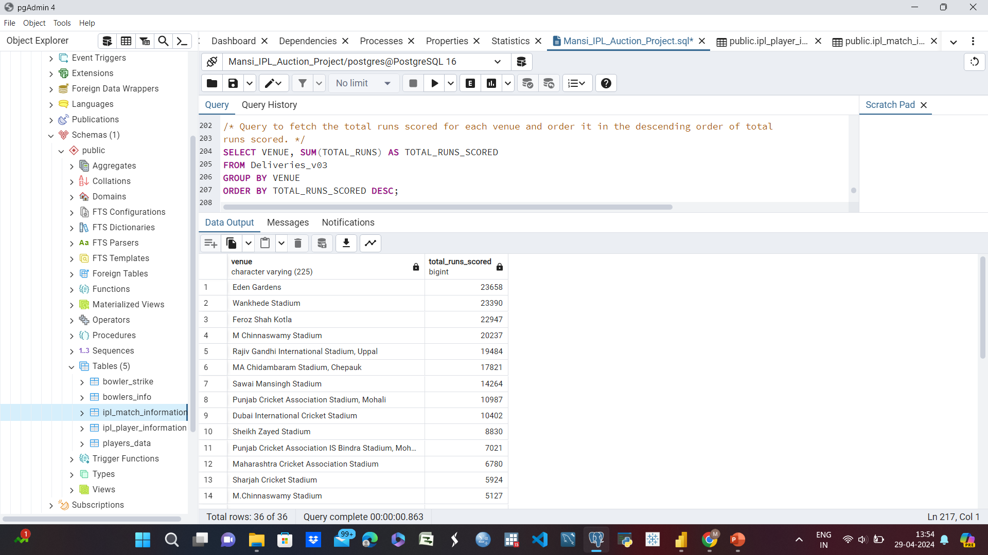
Additional Questions
9. Query to fetch the total runs scored for each venue and order it in the descending order of total runs scored.
10. Query to fetch the year-wise total runs scored at Eden Gardens and order it in the descending order of total runs scored.

Slide 28
Thank you

